Slide 1
Press Ganey Analytics Exercise
December 9, 2018
Sam Castillo

Slide 2
Overview
Intro
Description of tables
Data Merging
  Overview of tables
  Merged tables
Survey Results Summary
  Survey results by age and patient sex
  Survey results by mode of delivery
  Quality of care measures
  Performance benchmarking
Measuring Quality of Care
  How can Quality of Care be measured?
  What are the drivers of Quality of Care?
Application Example: Benchmarking
Future Considerations

Slide 3
Data Merging
Combining Data Sources

Slide 4
  Description of tables
Data Merging
Survey: Table that identifies, for each completed survey (identified by SurveyKey – one for each survey returned), the Mode the survey was conducted in.
SurveyItem: Table with fields relevant to content of survey:
  SurveyItemVariable: Question/rating that respondent is answering
  Survey
  ResponseCode: Rating scale of item. Many of our survey items ask ordinal response questions (e.g. on a scale to 1 to 5: completely disagree to completely agree), with a higher value being better.
  TopBoxCode: This is the value for the ResponseCode that we consider “TopBox” – the highest rating.
  SurveyItemReportName: Brief description of question corresponding to SurveyItemVariable
Patient: Demographics table with PatientSex and PatientBirthDateKey (all birth-dates changed to January 1). Birthdate is in format YYYYMMDD.
Response: Table with survey response value (SurveyResponse), in a key-value structure; e.g. one row per item, per respondent. Also includes fields used to merge with Survey, Patient and SurveyItem fields.

Slide 5
  Merged tables
Data Merging
See the attached R notebook for the data manipulations
The two outputs SurveyMatrix and MergedSurvey are attached

Slide 6
Survey Results Summary
Visualizations & Drill Down

Slide 7
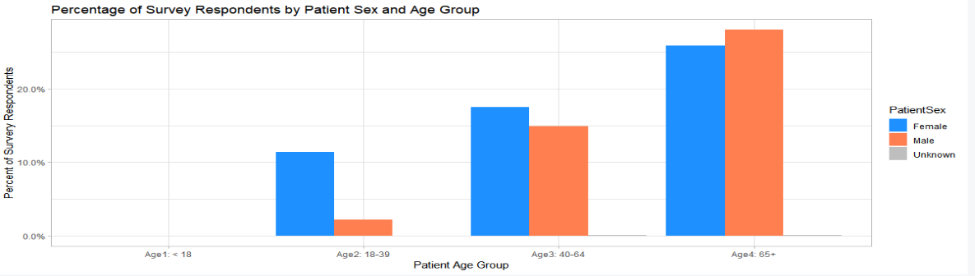
  Survey results by age and patient sex
Analysis
Most survey respondents are older
Less than 5% of male patients between the ages of 18-39 respond, whereas about 10% of female patients from this group do respond
Looking at the number of respondents instead of the percentage shows a very similar pattern

Slide 8
  Creating a performance measure
Analysis
“Top Box” performance shows the if a patient indicated that their quality or care was the highest possible value, a 4-out-of-4 rating
This performance measure can be split by any member characteristics such as the patient’s sex, age group, the mode of the survey, or other information

Slide 9
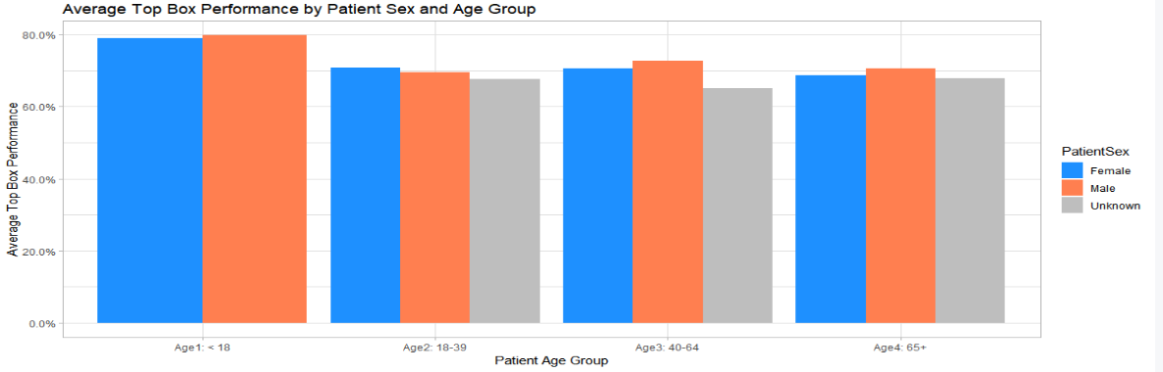
  Top box performance by age and patient sex
Analysis
Men have higher top box percentages for ages 40+, and women have higher responses on average between the ages of 18-39
Patients younger than 18 have higher responses on average. Is this because the quality of care is better or because they are spending less time completing the survey?

Slide 10
  Top box performance by mode of survey
Analysis
Surveys can be completed either online or in paper form
98% of patients completed the surveys in paper; 2% completed the surveys online

Slide 11
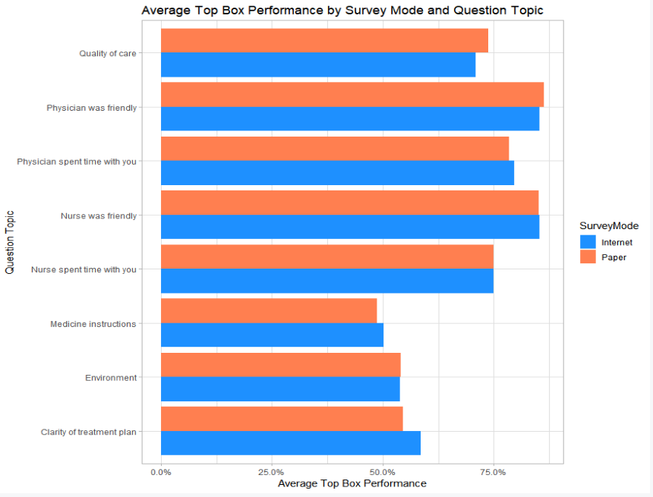
  Quality of care by mode of survey
Analysis
The biggest difference in performance from paper to online is in the overall “Quality of Care” and “Clarity of Treatment Plan”
It is not clear whether or not patients have a choice between online or paper form. If this is a choice, then there could be selection bias in the results. For instance, patients who are too sick to write out on a paper form may have a third party fill it out online for them
Patients indicate that the nursing staff was friendly about 80% of the time, which has very little difference between the mode of the survey
Patients consistently have questions about the medicine instructions as the Top Box percentage is about 50%

Slide 12
Measuring Quality of Care
Visualizations & Drill Down

Slide 13
  Drivers of quality of care
Quality of Care
There are two components
  1. What the patient fills out on the form. This is related to the overall “patient experience”
  2. The efficiency and proper medical treatment which the patient receives

Slide 14
  Drivers of quality of care
Quality of Care
These can be broken down into sub-components
  What the patient fills out on the form. This is related to the overall “patient experience”
    Do they feel cared for? Did the nursing staff and physician spend time with them?
    Were they comfortable? Did they have to wait in the ER for 5 hours? Was the environment relaxing?
  The efficiency and proper medical treatment which the patient receives
    Did they receive complete instructions on how to take their medication?
    Was the physician able to prescribe treatment or were they just referred on to another medical professional?
    Did they recover well or was there a relapse which results in further treatment?

Slide 15
  Drivers of quality of care
Quality of Care
Perceived Quality of Medical Care
Clarity of treatment plan
Medicine instructions
Quality of care
Survey Results
Actual Quality of Medical Care
Environment
Time spent with nurse
Time spent with physician
Nurse was friendly
Physician was friendly

Slide 16
  Drivers of quality of care
Quality of Care
Perceived Quality of Medical Care
Clarity of treatment plan
Medicine instructions
Quality of care
Patient recovery time
Mortality rates due to surgery
Surgical complication & infection rates
Survey Results
Actual Quality of Medical Care
Environment
Time spent with nurse
Time spent with physician
Nurse was friendly
Physician was friendly
Not in surveys

Slide 17
  Drivers of quality of care
Quality of Care
What is the distinction between “Top Box” and Quality of Care? This this is a highly debated question in health care today. This analysis is assuming that the two are correlated.
Patient Satisfaction from Survey Results
Quality of Medical Care Received

Slide 18
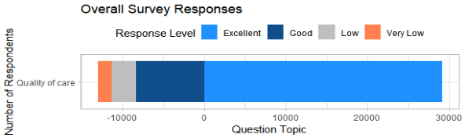
  Measuring quality of care from surveys
Quality of Care
Each question can be answered on a scale of 1-4.
For easier interpretation, let’s add labels to indicate a positive response verses a negative response
About 800 patients thought that it their quality of care was “Good”
About 3000 patients indicated that their “Quality of Care” was 4/4, or “Excellent”

Slide 19
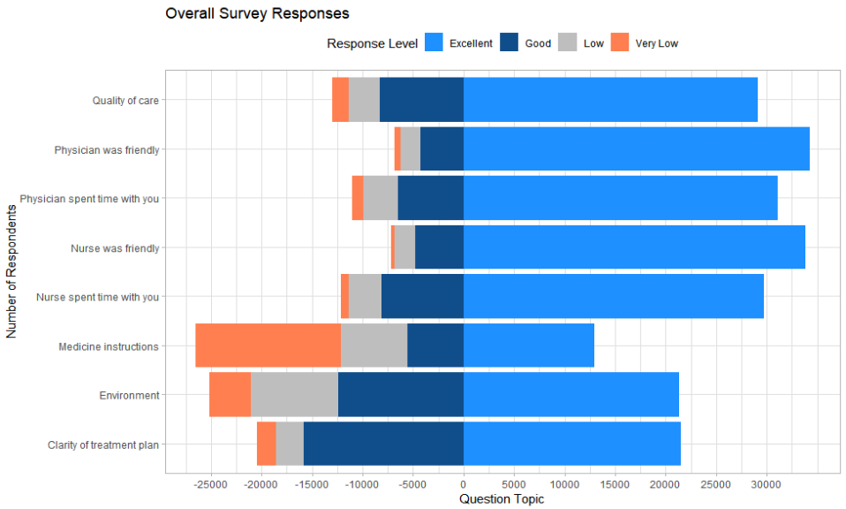
  Measuring quality of care from surveys
Quality of Care
About 10,000 patients said that their medicine instructions were poor

Slide 20
  Measuring quality of care from surveys
Quality of Care
Almost all patients (~30,000) said that the physician was friendly

Slide 21
  Recap: How should overall quality of care be measured?
Quality of Care
Should we just use the “Quality of Care” Top Box rate?
  How can we distinguish between cause and effect?. For instance, was having an unfriendly nurse the reason why a patient rated “Quality of Care” as 2 out of 4, or were they treated the same as other patients but upset due to a bad medical outcome and thus gave a low “friendliness” rating?
  How do patients interpret the overall “Quality of Care” rating? If some patients interpret this to mean strictly the ‘comfort’ of the experience and other patients the amount of medical attention, number of x-rays given, time spent with the physician, or other arbitrary factors, then how can this be a reliable source?

Slide 22
Client Benchmarking
Findings Opportunities for Improvement of Quality of Care

Slide 23
  Compare a given client to a benchmark
Benchmarking
Step 1: Create an industry benchmark. This can be as simple as an average of the top 10 clients or as complex as statistical measure including health risk score, the number of patients the sample, and other factors.
Step 2: For any split of the data, compare a given client to this benchmark
Step 3: If there is significant differences, such as if the client is behind in a certain area, start looking into why this might be the case
Step 4: Take action. Connect the low-performing client with resources from the top performers to answer the question “What is are they doing differently than we are”?

Slide 24
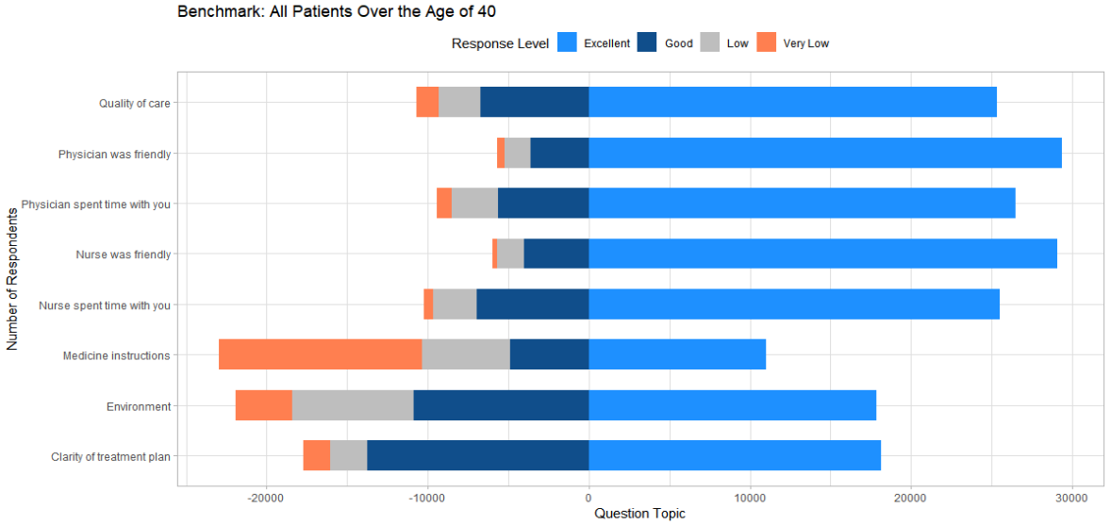
  Example: Patients over the age of 40 for Hospital ABC
Benchmarking
Industry Benchmark for patients over 40
This particular hospital is underperforming at giving providing good medicine instructions for patients over the age of 40

Slide 25
Future Considerations
Additional data sources

Slide 26
  Future Considerations
Future Considerations
What additional data sources would be add to this analysis?
  Time spent on survey. This is a way of measuring “survey fatigue” which is the level of interest and authenticity which the patient exhibits when filling out the survey. This can be used a to assign credibility to survey results
  Past medical history. A patient who goes to the hospital multiple times per year would have a different standard of “Quality of Care” than a patient who has only been once
  Time survey was completed. Was this when they were in the hospital or three weeks later once they were at home?
  If they had assistance in filling out the survey.
  Information of missing data. Which patients are not filling out surveys? Is this MCAR, MAR? What causes a patient to not fill out a survey?

